Slide 1
HR ANALYTICS
Employee Retention
BY
GROUP-3

Slide 2

overcoming nervousness
CONFIDENCE-BUILDING STRATEGIES

Slide 3
effective delivery techniques
Effective body language enhances your message, making it more impactful and memorable:
Meaningful eye contact
Purposeful gestures
Maintain good posture
Control your expressions
This is a powerful tool in public speaking. It involves varying pitch, tone, and volume to convey emotion, emphasize points, and maintain interest:
Pitch variation
Tone inflection
Volume control

Slide 4

speaking impact
Your ability to communicate effectively will leave a lasting impact on your audience
Effectively communicating involves not only delivering a message but also resonating with the experiences, values, and emotions of those listening

Slide 5
speaking impact
Learn to infuse energy into your delivery to leave a lasting impression
One of the goals of effective communication is to motivate your audience
METRIC | MEASUREMENT | TARGET | ACTUAL
Audience attendance | # of attendees | 150 | 120
Engagement duration | Minutes | 60 | 75
Q&A interaction | # of questions | 10 | 15
Positive feedback | Percentage (%) | 90 | 95
Rate of information retention | Percentage (%) | 80 | 85

Slide 6
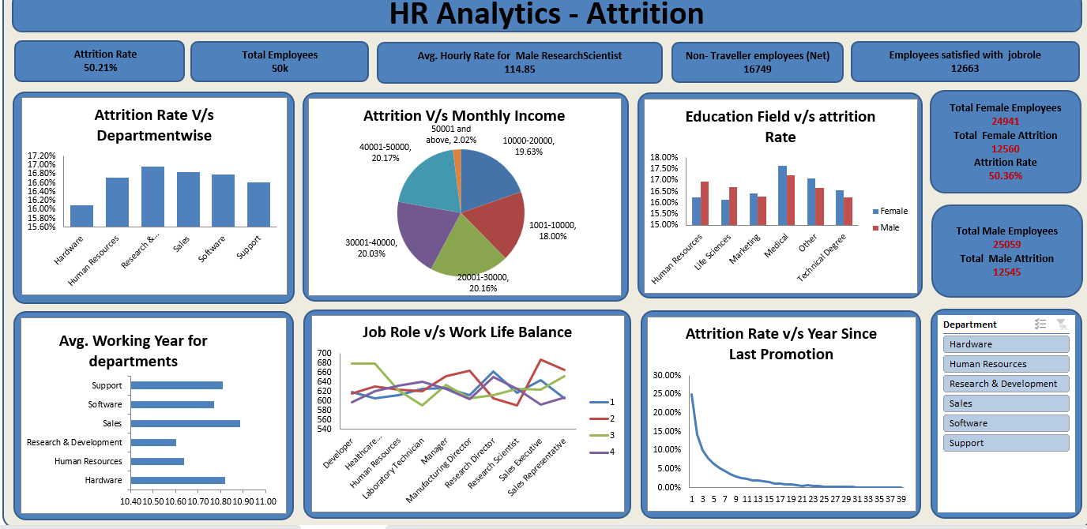
EXCEL DASHBOARD

Slide 7
Average Attrition Rate for All Departments
Attrition Rate: The percentage of employees who leave a department or the organization over a specific period.
Average Attrition Rate for All Departments: An overall metric showing the average rate at which employees are leaving across all departments.

Slide 8
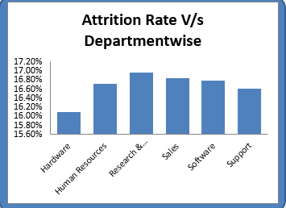
Displays attrition rates for each department, with an average line showing the overall average attrition rate.

Slide 9

Average Hourly Rate of Male Research Scientists
EXPLANATION:
The average amount paid per hour to male research scientists.This metric helps to ensure equitable pay and can be used to identify any pay discrepancies.
A simple card displaying the average hourly rate for male research scientists.

Slide 10
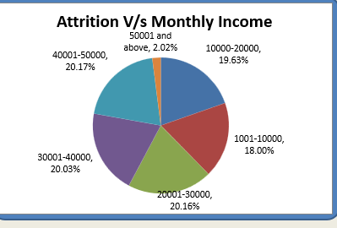
Attrition Rate Vs Monthly Income
EXPLANATION:
Examines the relationship between monthly income and attrition rates
Identifies if income levels influence employee retention.

Slide 11
The chart may show a higher proportion of attrition in lower income brackets.
This can indicate that employees with lower salaries are more likely to leave the company.

Slide 12
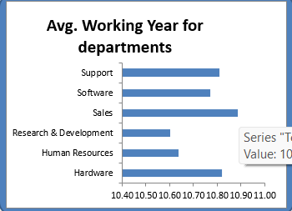
Average Working Years for Each Department
Average number of years employees have worked in each department.
Indicates departmental stability and employee loyalty.
Explanation:

Slide 13
Departments with High Average Working Years: Departments with high average working years may indicate good employee retention, suggesting positive work environments and job satisfaction.
Departments with Low Average Working Years: Conversely, departments with lower average working years might be experiencing higher turnover, which could signal issues like job dissatisfaction, lack of growth opportunities, or other challenges.
The bar chart visualizes the average working years for each department, making it easy to compare retention across different areas of the organization. Each bar represents a department, and the height of the bar indicates the average tenure of employees in that department.

Slide 14
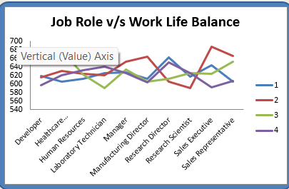
Job Role Vs Work Life Balance
EXPLANATION:
Compares work life balance ratings across different job roles.
Identifies roles that may require better work life balance initiatives.

Slide 15
Variation in Work-Life Balance Across Job Roles: The bar chart reveals how different job roles perceive their work-life balance. Roles with lower work-life balance scores might indicate higher job demands or less flexibility.
High Work-Life Balance Roles: Identifying job roles with high work-life balance scores can help understand which roles offer better flexibility, job satisfaction, and manageable workloads.
Low Work-Life Balance Roles: Job roles with lower work-life balance scores may require attention to improve conditions, which could include workload management, flexible working hours, and additional support.

Slide 16
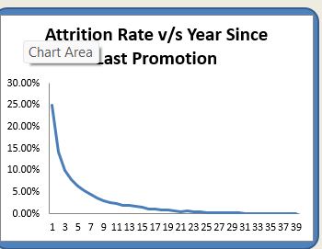
Attrition Rate Vs Years Since Last Promotion
Explanation:
Analyzes if the number of years since the last promotion affects the likelihood of attrition.
Identifies if there is a need for more frequent promotions or career development opportunities.

